Slide 1
Using SUMO
(Simulation of Urban MObility)

Slide 2
Slides

Slide 3
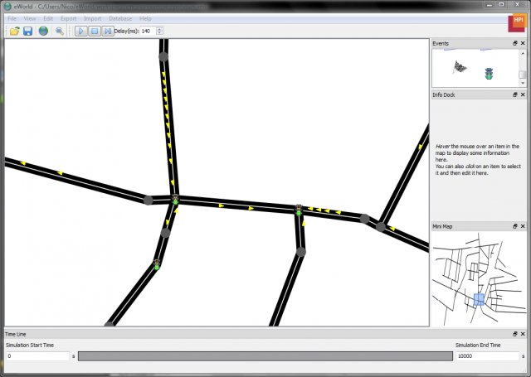
What is it?
SUMO is a open source package which allows you to simulate traffic
It gives you a lot of control so that you may fine tune the behavior of the roads and vehicles

Slide 4

Terms
edge
node
node

Slide 5
Building a simulation
Nodes
Edges
Network (product of nodes and edges)
Vehicles
Routes

Slide 6
Nodes
id - unique identifier
x, y - distance from the origin in meters
These definitions go in a file with a .nod.xml extension
Example:
<nodes>
<node id="1" x="-250.0" y="0.0" />
<node id="2" x="+25050.0" y="0.0" />
</nodes>

Slide 7
Building a simulation
Nodes
Edges
Network (product of nodes and edges)
Vehicles
Routes

Slide 8
Edges
id - unique identifier
from - node car comes from
to - node car goes to
These definitions go in a file with a .edg.xml extension
Example:
<edges>
<edge from="1" id="1to2" to="2" />
<edge from="2" id="out" to="3" />
</edges>

Slide 9
Building a simulation
Nodes
Edges
Network (product of nodes and edges)
Vehicles
Routes

Slide 10
Network
A definition of nodes and edges that can be recognized by other programs (SUMO)
Netconvert
A tool included in the SUMO installation which takes in node and edge xml files and generates a network definition.
Example usage from the command line:
netconvert --node-files=hello.nod.xml --edge-files=hello.edg.xml --output-file=hello.net.xml

Slide 11
Building a simulation
Nodes
Edges
Network (product of nodes and edges)
Vehicles
Routes

Slide 12
Defining Vehicles
accel - acceleration of the car (m/s^2)
decel - deceleration of the car (m/s^2)
id - unique identifier
length - car length in meters
maxspeed - car’s maximum speed (m/s^2)
sigma - driver imperfection (between 0 and 1)
Example:
<vType accel="1.0" decel="5.0" id="Car" length="2.0" maxSpeed="100.0" sigma="0.0" />

Slide 13
Instantiating a Vehicle
id - unique identifier
depart - time in milliseconds before car is spawned
type - id of a defined vehicle
route - path taken
Example:
<vehicle depart="1" id="veh0" route="route0" type="Car" />

Slide 14
Building a simulation
Nodes
Edges
Network (product of nodes and edges)
Vehicles
Routes

Slide 15
Routes
id - unique identifier
edges - a list of edges, separated by spaces, which define the route the vehicle will take
Example:
<route id="route0" edges="edge1 edge2"/>

Slide 16
Building a simulation
Nodes
Edges
Network (product of nodes and edges)
Vehicles
Routes

Slide 17
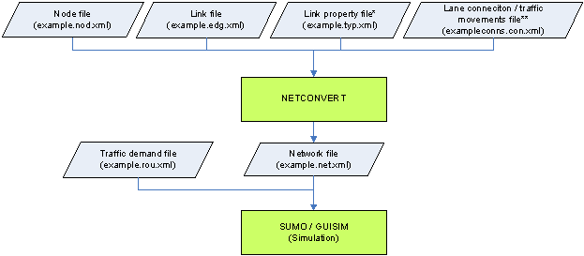

Slide 18
Runnning the simulation
sumo-gui
A tool included in SUMO to create a visualization for your simulation
All you need to do is provide it with a config file which gives the paths to your routes, network, etc.. and it does the rest

Slide 19
DEMO 1

Slide 20
Road Types
You can define different types of edges each with their own attributes in a file with a .typ.xml extension
priority - the priority of that road based on traffic regulations. Defined by an integer
numLanes - number of lanes
speed - max speed on that edge
Example:
<type id="a" priority="3" numLanes="3" speed="13.889"/>

Slide 21
DEMO 2

Slide 22
Using OpenStreetMap to create networks
It’s as simple as choosing an area on a map; No XML to define
Allows you to model real-world locations with ease

Slide 23
Getting the data
Goto https://www.openstreetmap.org/ to select the area of the world you would like to model

Slide 24
Convert osm data to a network
We will use netconvert from the commandline with an additional flag
netconvert --osm-files file.osm.xml -o file.net.xml

Slide 25
Getting polygons from the osm data
The data from OpenStreetMap also provides figures in that area which allow for a more realistic simulation
polyconvert --net-file file.net.xml --osm-files file.osm -o file.poly.xml

Slide 26
DEMO 3

Slide 27
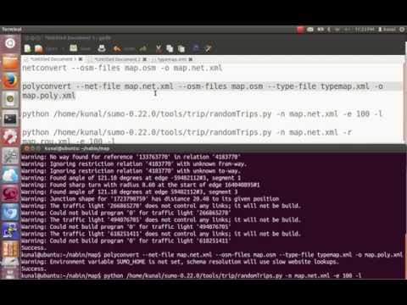

Slide 28
Using TraCI
TraCI is a traffic control interface
It allows you to alter your simulation in real time using a python script which receives information from the simulation

Slide 29
DEMO 4

Slide 30
Output Analysis

Slide 31
Vehicle Positions
You can receive the location of every vehicle at a user-specified interval of the simulation
This can be useful for detecting traffic jams or any other slowdowns

Slide 32
Emission
You can receive data on the amount of car emissions per vehicle
This would be very useful in making predictions for future amounts of car emissions
Can help individuals or companies quantify the impact of their travel on the environment

Slide 33
Trip Info
Data on the departure and arrival time of each vehicle, number of stops, etc…
Useful for taxi companies in calculating the efficiency of routes taken

Slide 34
More Info
http://sumo.dlr.de/wiki/Simulation_of_Urban_MObility_-_Wiki

Slide 35
Code for Demos
https://github.com/bigolu/sumo-presentation

